Slide 1

Process Mining Virtual Internship
by
B. Rishitha
Roll No. 204G1A3286
Department of Computer Science and Engineering (Data Science)
Srinivasa Ramanujan Institute of Technology
(Affiliated to JNTUA & Approved by AICTE) (Accredited by NAAC with ‘A’ Grade & Accredited by NBA (EEE, ECE & CSE)
Rotarypuram Village, B K Samudram Mandal, Ananthapuramu – 515701.
2023 - 2024

Slide 2

Contents
Course Objective
Introduction
Technology
Applications
Modules
Real Time applications
Learning outcomes
GitHub Link
Queries

Slide 3
Course Objective
Be able to relate the academic theory and technical methods that are used to visualize the functionalities of process mining.
Be able to relate process mining techniques to other analysis techniques such as simulation, business intelligence, data mining, machine learning, and verification.
Be able to apply basic process discovery techniques to learn a process model from an event log both manually and using tools.

Slide 4
Introduction
Our world and the organizations in it are full of processes from purchasing to order management. Since, now-a-days organizations are dealing with simple or complexed global processes respectively based on situations.
Process mining involves in analysing event data to gain insights into how processes are executed. It helps uncover patterns, deviations, and performance metrics to optimize processes and make data-driven decisions.
In the business perspective, process mining is a powerful tool for understanding and improving business processes. It allows us to analyse event data and visualize the end-to-end flow of activities, helping us identify inefficiencies, and irregular areas for improvement.

Slide 5
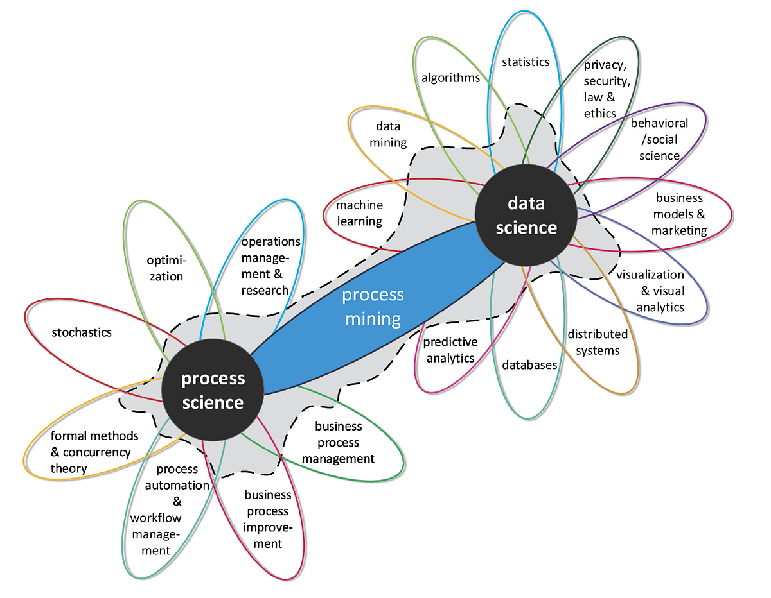
Contd...
Basically, process mining is the combination of both data science and process science as shown in the figure.

Slide 6
Technology
In process mining, various technologies are used to analyse and visualize event data in both data science and business perspectives. Since, process mining play's crucial role in both data science and business processes.
Process Mining works on a technical level and it's growing as an exciting new technological sector opening up significant opportunities for businesses across the world.
In process mining, various technologies are utilized to analyse event data and extract valuable insights. Some of the key technologies used in process mining include:
1. Data extraction tools: These tools help extract event data from various sources, such as log files, databases, or enterprise systems.

Slide 7
Contd...
2. Process discovery algorithms: These algorithms automatically generate process models based on the event data, allowing for a visual representation of the actual process flow.
3. Process enhancement: This refers to using process mining insights to suggest improvements, such as optimizing resource allocation, redesigning process flows, or identifying automation opportunities.
4. Process visualization tools: These tools enable the visualization of process models and data, making it easier to understand the flow and identify areas for improvement.
5. Machine learning and AI techniques: These techniques are often used to enhance process mining capabilities, such as predicting future process behaviour or automating certain tasks.

Slide 8
Applications
Supply Chain Management: Process mining can be used to analyze and optimize the end-to-end supply chain process, and improve inventory management and order fulfillment.
Healthcare Process Improvement: Process mining can be applied in healthcare settings to analyse patient pathways, identify inefficiencies, reduce waiting times, and improve the overall quality of care.
Fraud Detection: Process mining techniques can be used to detect and prevent fraudulent activities by analysing patterns and anomalies in transactional data.
Compliance Monitoring: Process mining can assist in monitoring and ensuring compliance with regulations and internal policies by analysing process execution against predefined rules.

Slide 9
Modules
Level 1- Introduction to Process Mining
What is Process Mining?
Importance of Process Mining.
Process Mining in Action.
Importance of Process Mining:
Process mining is important because it provides organizations with valuable insights into their business processes. It allows them to understand how processes are actually executed. Since, process mining plays crucial role in data process and business sectors.
Process Mining in Action:
Process mining in action is like having a behind-the-scenes view of your business processes. It involves analysing event data and visualizing the actual flow of activities, resources, and decisions.

Slide 10
Contd...
Level 2: Foundations of Process Mining
Process Mining Fundamentals
Review and Interpret Analyse.
Build Analys.
Process mining fundamentals:
Process Mining is the combination of two disciplines: Data Science and Business Process Management. Process Mining essentially uses Data Science techniques, such as Big Data and AI, to address Process Science problems such as process improvement and automation.
The process Mining technology uses the digital footprints to automatically visualize and reconstruct the process flow to get 100% transparent and object view on how process actually run.

Slide 11
Review and Interpret Analysis
Navigate to an Analysis
Once you want to navigate into analysis, you will find a vertical bar. To get familiarized with navigating to analysis you have to know space, package and asset relationship. It is a hierarchal relationship. Space contains packages and packages contains assets.
The Variant Explorer and The Process Explorer
The Variant Explorer focuses on identifying and visualizing the various process variants that exist within a dataset. A process variant represents a distinct path of activities and decisions that a process can take during execution. The Process Explorer, on the other hand offers a more detailed view of the process’s execution by focusing on individual process instances and their attributes. It helps you understand the specific details of each case as it moves through the process.

Slide 12
Charts and Tables
Charts and tables are powerful visual tools that can be utilized effectively in process mining to analyse and communicate insights derived from event logs. They help you present complex data in a clear and understandable manner
Selection views
Selection views allow you to zoom in on specific aspects of your process, which can lead to deeper insights and more targeted process improvements. Different process mining software tools offer various ways to create and manipulate these views, empowering you to tailor your analysis to the questions you need to answer or the issues you're aiming to address.
The Case Explorer
The Case Explorer is a feature in process mining software tools that allows users to explore and analyse individual process instances or cases in detail.

Slide 13
The Conformance Checker
The Conformance Checker is a crucial component of process mining tools that help as recorded in event logs, and the expected or predefined process model. Its primary purpose is to identify discrepancies, deviations, and non-compliance issues between the observed process behaviour and the intended process design.
Save and Share Analysis
Selection Saving and sharing process mining analyses is essential for collaboration, documentation, and knowledge dissemination within your organization. Process mining tools often offer various ways to save and share your analysis results.

Slide 14
Contd...
Level 03: Rising Technical Star!
Write PQL Queries
Get Data into the EMS
Write PQL Queries
Celonis PQL is an integral component of the Celonis Software Architecture. All Celonis applications use this language to query data from a data model.
PQL (Process Query Language) Queries are an essential component of process mining. They allow analysts to extract valuable insights from process data.
PQL Queries enable you to explore and analyse process behaviour, identify bottlenecks, measure performance, and discover patterns within the data.

Slide 15
Contd...
Get Data into the EMS
Get data into EMS involves integrating data from various sources such as ERP systems, databases, log files, and other data formats.
Process data is important because it serves as the very foundation for others to analyse and act on. Without this data, no other activities can take place within the EMS and you won’t be able to mine, improve, act on, or automate your processes.
Build and refine your data pipeline
Data Integration helps you connect to source systems, extract the relevant data, transform it to your needs, and load it into a polished Data Model.
Data Model is the fuel to all other work in your EMS.

Slide 16
Contd...
When building the data model, you are also responsible for validation, scheduling, monitoring as well as optimizing performance
Therefore, We Can Conclude That:
Introduction to Process Mining
Foundation of Process Mining
Rising Technical Star
EWS

Slide 17
Real Time applications
Financial Process Compliance: Process mining can assist in monitoring financial transactions to ensure compliance with regulations and internal controls.
Customer Journey Analysis: By analyzing customer interactions and touchpoints in real time, businesses can understand the customer journey better
Manufacturing Process Improvement: Manufacturers can use process mining to monitor production lines in real time, identifying deviations from the expected process flow.
Logistics and Transportation: Process mining can optimize logistics and transportation processes by providing real-time visibility into the movement of goods.

Slide 18
Learning Outcomes
Process mining can lead to several valuable learning outcomes, equipping individuals with the knowledge and skills necessary to analyze and optimize business processes effectively. Here are some key learning outcomes of process mining:
Understanding of Process Concepts
Data Preparation and Collection:
Data Cleaning and Preprocessing
Performance Analysis
Root Cause Analysis
Process Enhancement and Redesign

Slide 19
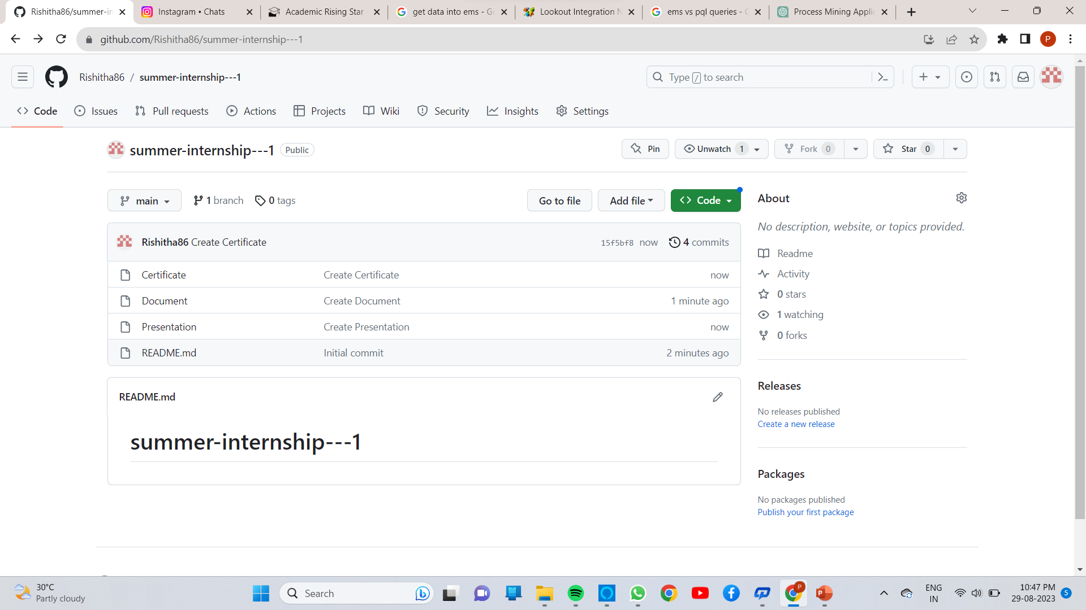
Git Hub Dashboard

Slide 20
Any Queries?

Slide 21
Thank You!!!

